Slide 1








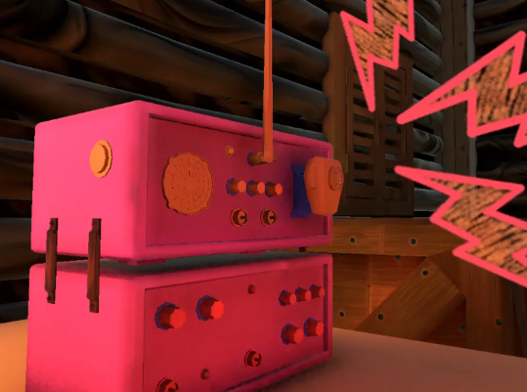
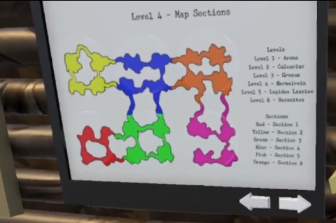


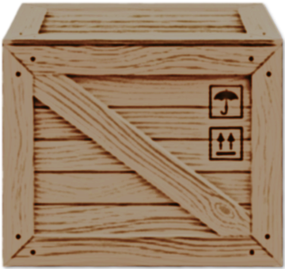






Stuck in a wooden cabin in the middle of a snowstorm, it's up to you to coordinate with your team and escape together.
Explore and interact with your surroundings for clues;
Gather and organize any intel on a special board;
Help your friends by communicating via an old transceiver radio.
Escape Room;
1st Person View;
Single Player;
Windows PC.
Alexandre Teixeira André Sebastião Daniela Peixoto Rodrigo Pires Vitor Daniel

